Slide 1
Scene Management and Rendering

Slide 2
Scene Management Goals
Organize the scene geometry in a way that will support fast queries of that geometry
  Process the geometry in a way that we can render it efficiently
  Handle collision detection
  A.I.

Slide 3
Scene Management
Is responsible for:
  Hierarchy Flattening
  Getting the viewable set
    Spatial System
    Frustum Culling
  Sorting
    Opaque set
    Transparent set
    RenderContext sorting
  Rendering

Slide 4
Render System
The Render System is responsible for rendering sets (batches/RenderSets) of geometry.
“Stupid” Render System
  Doesn’t do any geometry processing.
All the platform specific rendering code is kept here. Allowing you to have a Render System for OpenGL, D3D, or for a specific console.

Slide 5
Base Render System Objects

Slide 6
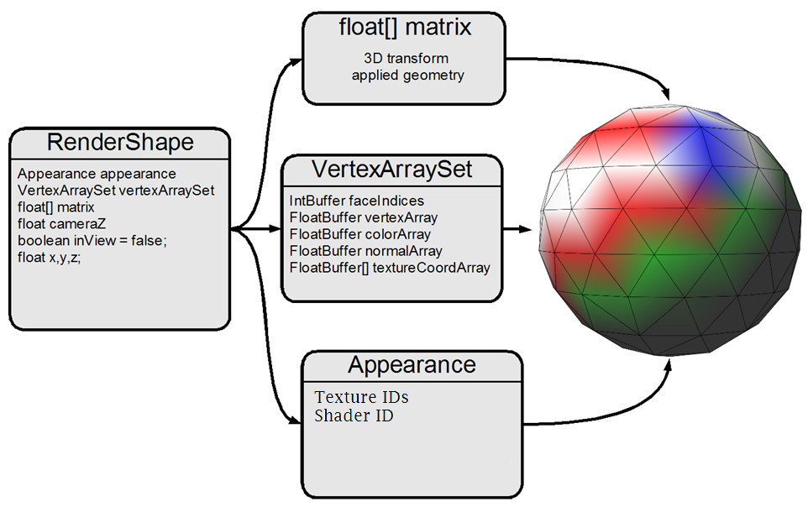

Slide 7
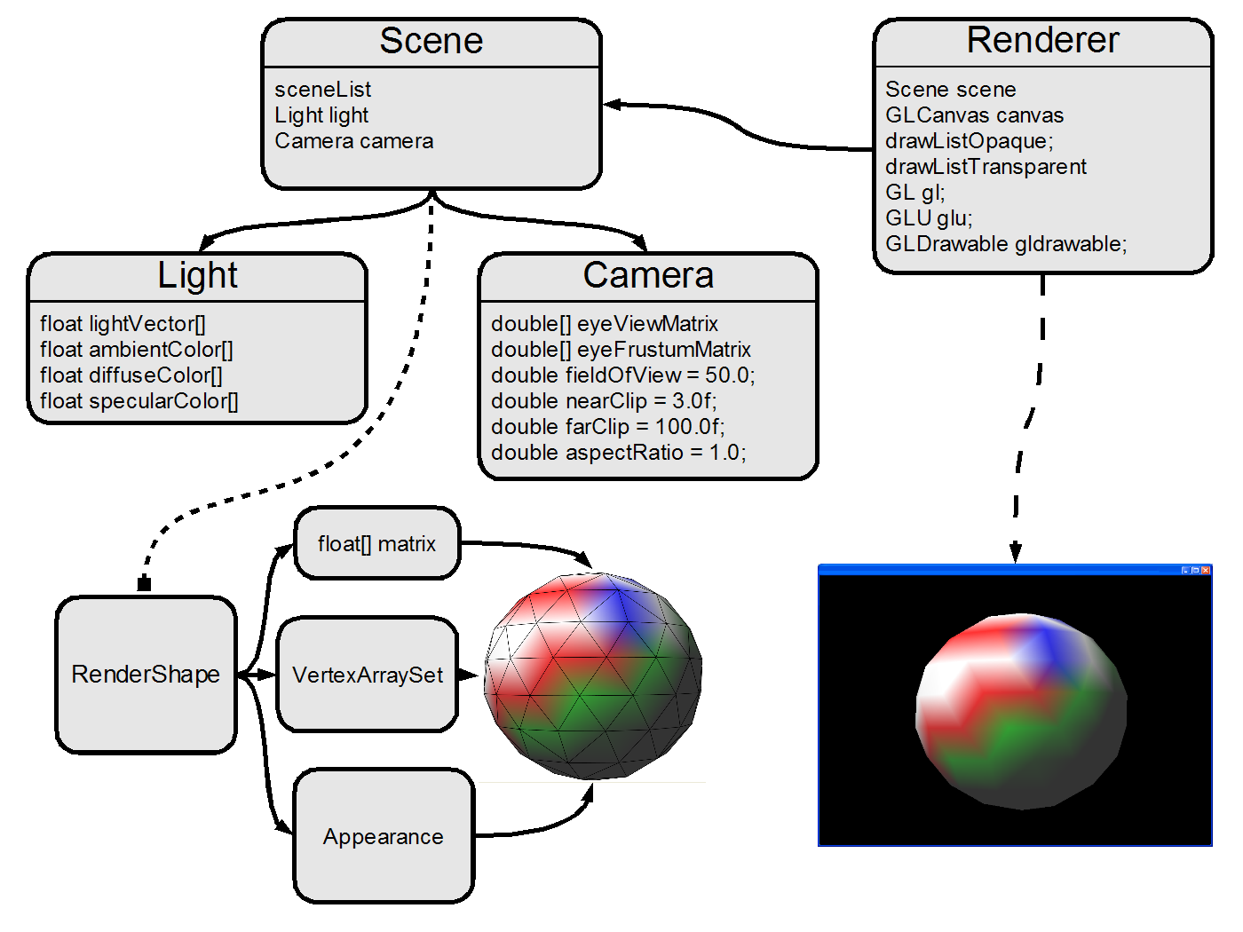

Slide 8
RenderNode
This is the base object that is processed by the Render System
  Any object that can be processed by the render system will inherit from RenderNode
Contains a function pointer that gets assigned a function by the Render System, because this function contains API/Platform specific code
  but is not limited to this
To “render” a RenderNode it’s renderProcess calls its RenderFunc (function pointer) on itself
Notes:
Show how the Render System will process these nodes.

Slide 9
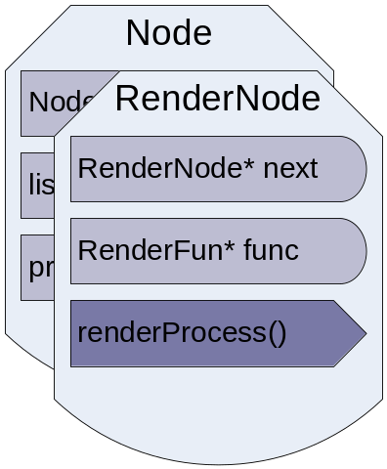
RenderNode Definition
typedef void (*RenderFunc)(RenderNode *rNode);
class RenderNode
{
RenderNode *next; // Used in RenderSets
RenderFunc func; // Function object
// Process used by the RenderSystem
inline void renderProcess() { func(this) };
};

Slide 10
RenderFunc
Benefits to this are three fold
  Gives a layer of abstraction between our scene management and platform specific code
  Allows an alternative to making the renderProcess function virtual
  Allows for custom operations to be applied to that specific RenderNode in the Render System without changing the our render pipeline.
    i.e. a render “hook”

Slide 11
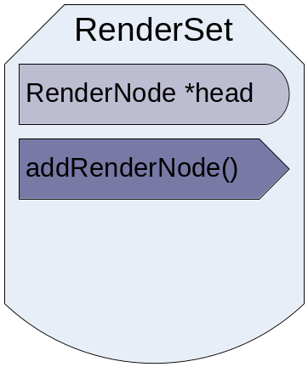
RenderSet
Render sets are what eventually get sent to the Render System to get processed.
It is a linked list of RenderNodes.
Typedef RenderNode * RenderSet;
  Head of the list. Would be the simplest form of a RenderSet. This is why our RenderNode’s have a next pointer
You can make this a class to create special RenderSets

Slide 12
Render Objects Extended

Slide 13
RenderContext/Appearance
Defines the render settings (Context) for a object or group of objects
Objects will be sorted into RenderSets by their contexts, then those RenderSets sent to the Render System to be processed
The less context switches we do in hardware the faster the render will be

Slide 14
RenderContext continued
Inherits from RenderNode
Stores an object’s render settings
  Shader, textures ids, opacity, cull mode…
Applies the render settings through the use of the RenderFunc it receives from the Render System

Slide 15
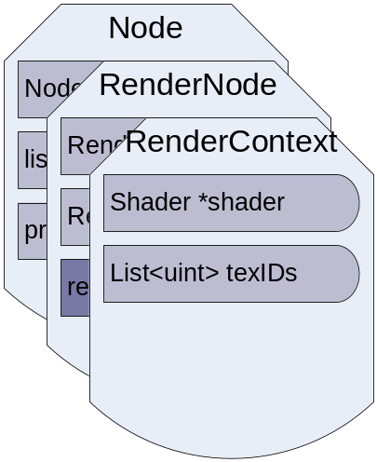
RenderContext Defined
class RenderContext : public RenderNode
{
// Any other render settings you are keeping track of…
// Pointer to the shader object.
Shader m_Shader;
// list of textures.
std::vector<TexID> texIds;
// Remember, the RenderContext inherits from
//RenderNode so it still has a RenderFunc to be set.
};

Slide 16
Drawable/RenderShape
Inherits from RenderNode
Is a container for a draw-able object
Stores the objects Mesh, World Matrix, Context
  This allows for instancing of the Mesh and context object
Its RenderFunc will be supplied with a generic render function by the Render System

Slide 17
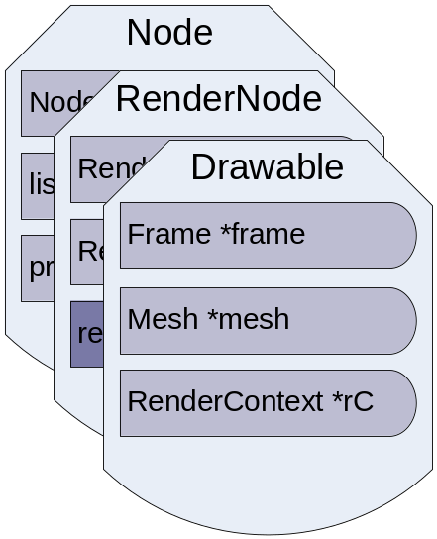
RenderShape Defined
class RenderShape: public RenderNode
{
private:
RenderContext &m_Context;
Mesh &m_Mesh;
Matrix worldMatrix;
Sphere m_Bounds; // Bounding volume.
Public:
// The overloaded process function. That calls the renderfunc.
// Inherited from RenderNode
//void RenderNode::renderProcess(void) { func(this); }
// Accessors …
};

Slide 18
Mesh/VertexArraySet
Object for storing the geometric information.
Stores all the indices, vertices, normals, colors, texcoordsN
  Could store the bone indices and weights for skinned animation
Can also read and write the mesh to file

Slide 19
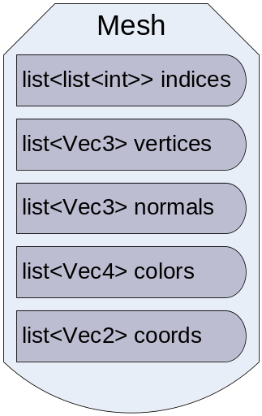
Mesh Definition
class Mesh
{
std::vector<UINT> indices; // Triangles indices
std::vector<Vec3> vertices, normals; // The verts & nomals
std::vector<Vec4> colors; // The colors
std::vector<std::vector<Vec2>> texcoords; // Multiple texcoords
public:
// Class Methods
bool readFromFile(FILE *file);
bool writeToFile(FILE *file);
};

Slide 20
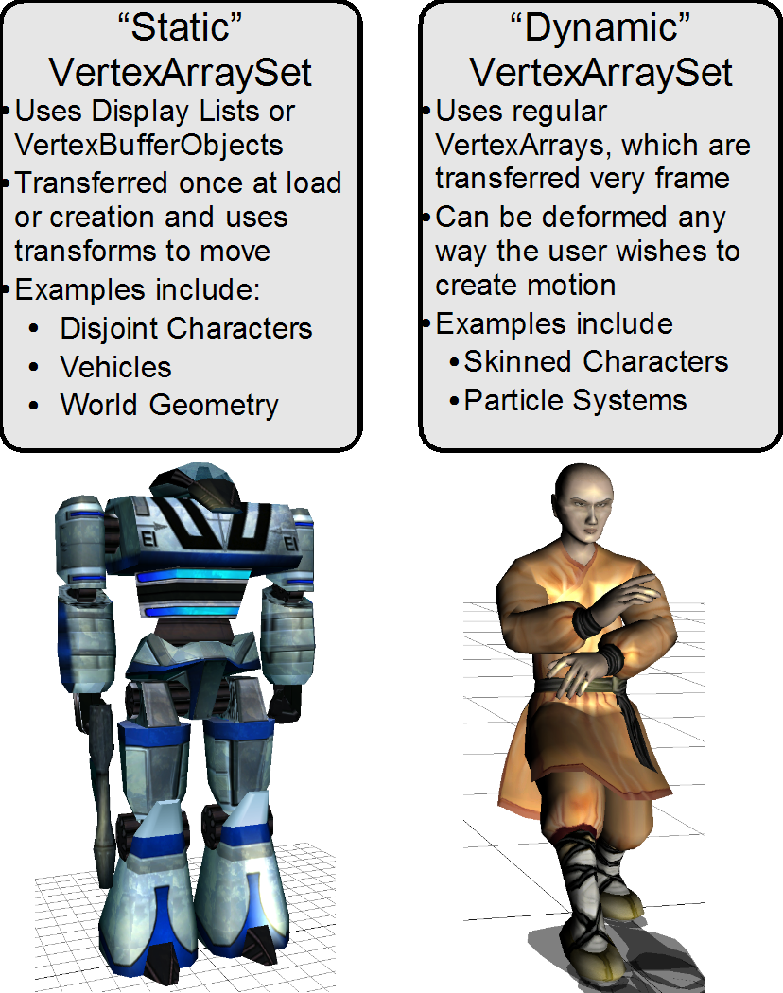

Slide 21
Using the Render System

Slide 22
Typical use of the Render System
Every frame:
Get the visibleSet from the spatial system
  visibleSet == all visible nodes
Sort this visibleSet by RenderContext and put into RenderSets
Pass RenderSet to the Render System
The Render System will simply run through all the RenderNodes can call their renderProcess functions

Slide 23
